Slide 1

14300 - Hard working
Little cutes (小可愛) 出頭天!!!

Slide 2
Outline
Description
Input & Output
Basic testcase
Concept & Code

Slide 3
Outline
Description
Input & Output
Basic testcase
Concept & Code

Slide 4
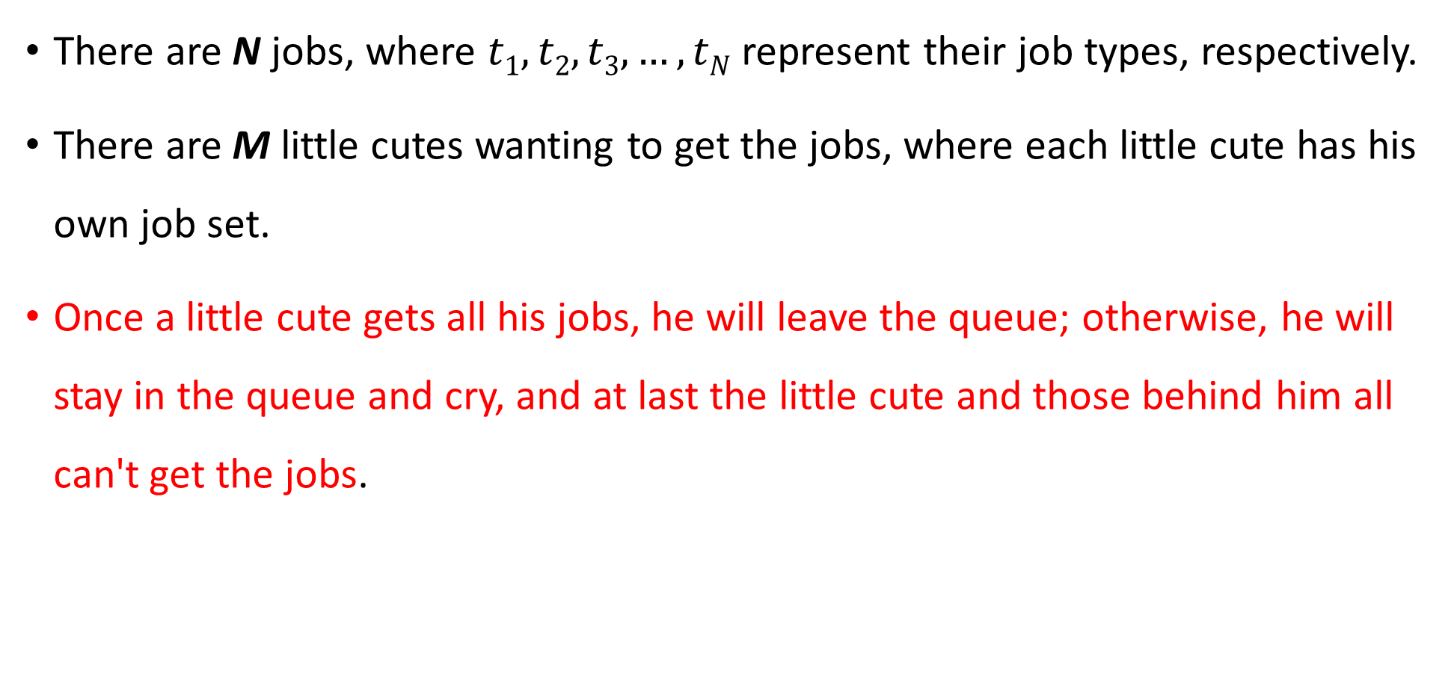
Description
There are N jobs, where $t1, t2, t3, …, tN$ represent their job types, respectively.
There are M little cutes wanting to get the jobs, where each little cute has his own job set.
Once a little cute gets all his jobs, he will leave the queue; otherwise, he will stay in the queue and cry, and at last the little cute and those behind him all can't get the jobs.

Slide 5
Description
Note that when choosing a job, among jobs of this type, a little cute will choose the job with the smallest job_id (1 ≤ job_id ≤ N).
Each job can only be chosen once.
For each job, you should output the little_cute_id (1 ≤ little_cute_id ≤ M) of the little cute who has taken it, or 0 if nobody does.

Slide 6
Outline
Description
Input & Output
Basic testcase
Concept & Code

Slide 7
Input
The first line of input contains the two positive integers: the number of little cutes M, and the number of jobs N.
Next, there would be M job sets, each represented by two lines:
1) the first line contains a single positive integer k_{j}, denoting the size of the jth little cute's job set;
2) the second line contains k_{j} integers, each denoting one of the job types in this job set.
Finally, there would be N integers, t₁∼ t_{N}, indicating the type of each job.

Slide 8
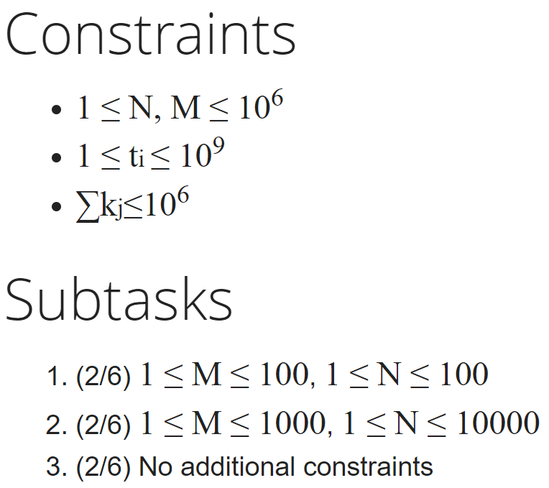
Input

Slide 9
Output
Output N lines, each containing a single integer, indicating which little cute has taken the corresponding job.

Slide 10
Outline
Description
Input & Output
Basic testcase
Concept & Code

Slide 11
Basic testcase
sample input
sample output
M = 4
M job sets:
2
1 2
3
2 3 4
1
4
2
2 3
N = 10
N job types:
2, 1, 1, 4, 4, 3, 2, 2, 1, 3
Who take the jobs:
1, 1, 0, 2, 3, 2, 2, 4, 0, 4

Slide 12
Basic testcase
sample input
sample output
M = 4
M job sets:
2
1 2
3
2 3 4
1
4
2
2 3
N = 10
N job types:
2, 1, 1, 4, 4, 3, 2, 2, 1, 3
Who take the jobs:
1, 1, 0, 2, 3, 2, 2, 4, 0, 4

Slide 13
Basic testcase
sample input
sample output
M = 4
M job sets:
2
1 2
3
2 3 4
1
4
2
2 3
N = 10
N job types:
2, 1, 1, 4, 4, 3, 2, 2, 1, 3
Who take the jobs:
1, 1, 0, 2, 3, 2, 2, 4, 0, 4
Taken by little cute 1

Slide 14
Basic testcase
sample input
sample output
M = 4
M job sets:
2
1 2
3
2 3 4
1
4
2
2 3
N = 10
N job types:
2, 1, 1, 4, 4, 3, 2, 2, 1, 3
Who take the jobs:
1, 1, 0, 2, 3, 2, 2, 4, 0, 4
It’s also taken by little cute 1

Slide 15
Basic testcase
sample input
sample output
M = 4
M job sets:
2
1 2
3
2 3 4
1
4
2
2 3
N = 10
N job types:
2, 1, 1, 4, 4, 3, 2, 2, 1, 3
Who take the jobs:
1, 1, 0, 2, 3, 2, 2, 4, 0, 4
The two jobs are taken by No.1

Slide 16
Basic testcase
sample input
sample output
M = 4
M job sets:
2
1 2
3
2 3 4
1
4
2
2 3
N = 10
N job types:
2, 1, 1, 4, 4, 3, 2, 2, 1, 3
Who take the jobs:
1, 1, 0, 2, 3, 2, 2, 4, 0, 4

Slide 17
Basic testcase
sample input
sample output
M = 4
M job sets:
2
1 2
3
2 3 4
1
4
2
2 3
N = 10
N job types:
2, 1, 1, 4, 4, 3, 2, 2, 1, 3
Who take the jobs:
1, 1, 0, 2, 3, 2, 2, 4, 0, 4

Slide 18
Basic testcase
sample input
sample output
M = 4
M job sets:
2
1 2
3
2 3 4
1
4
2
2 3
N = 10
N job types:
2, 1, 1, 4, 4, 3, 2, 2, 1, 3
Who take the jobs:
1, 1, 0, 2, 3, 2, 2, 4, 0, 4

Slide 19
Basic testcase
sample input
sample output
M = 4
M job sets:
2
1 2
3
2 3 4
1
4
2
2 3
N = 10
N job types:
2, 1, 1, 4, 4, 3, 2, 2, 1, 3
Who take the jobs:
1, 1, 0, 2, 3, 2, 2, 4, 0, 4
The three jobs are taken by No.2

Slide 20
Basic testcase
sample input
sample output
M = 4
M job sets:
2
1 2
3
2 3 4
1
4
2
2 3
N = 10
N job types:
2, 1, 1, 4, 4, 3, 2, 2, 1, 3
Who take the jobs:
1, 1, 0, 2, 3, 2, 2, 4, 0, 4
This job is taken by No.3

Slide 21
Basic testcase
sample input
sample output
M = 4
M job sets:
2
1 2
3
2 3 4
1
4
2
2 3
N = 10
N job types:
2, 1, 1, 4, 4, 3, 2, 2, 1, 3
Who take the jobs:
1, 1, 0, 2, 3, 2, 2, 4, 0, 4
The jobs are taken by No.4

Slide 22
Outline
Description
Input & Output
Basic testcase
Concept & Code

Slide 23
Concept (0-1) Input Data
int main() {
int m, n; cin >> m >> n;
vector<int> job_set[m]; // job sets for m little cutes
for(int i = 0; i < m; i++) {
int k; cin >> k;
job_set[i].resize(k);
for(int j = 0; j < k; j++) {
cin >> job_set[i][j];
}
}
vector<int> job_type(n);// job types for n jobs
for(int i = 0; i < n; i++) {
cin >> job_type[i];
}

Slide 24
Concept (0-2) Output Function
void print(vector<int> &v){
for(int i = 0; i < v.size(); i++) {
cout << v[i] << endl;
}
}

Slide 25
Concept (1-1)
1 ≤ M ≤ 100, 1 ≤ N ≤ 100
For each job set, we use linear search method to check whether the job has been taken.
Any of the job set’s jobs doesn’t exist or has been taken?
if yes: the other little cutes behind him can’t get the job, meaning that we need to break up the for loop;
if no: he gets all the jobs he want.

Slide 26
Concept (1-2) Code
vector<int> ans(n);// job i is taken by ans[i]
for(int i = 0; i < m; i++) {
vector<int> job_taken_list; // which jobs he has taken
for(int j = 0; j < job_set[i].size(); j++) {
int index = Find(job_type, job_set[i][j]); // linear search
if(index == -1) {//didn't find the job he wants
print(ans); return 0;
}
job_taken_list.push_back(index);
job_type[index] = -1; // this job has been taken
}
// update answer
for(int j = 0; j < job_taken_list.size(); j++) {
ans[job_taken_list[j]] = i + 1;
}
}

Slide 27
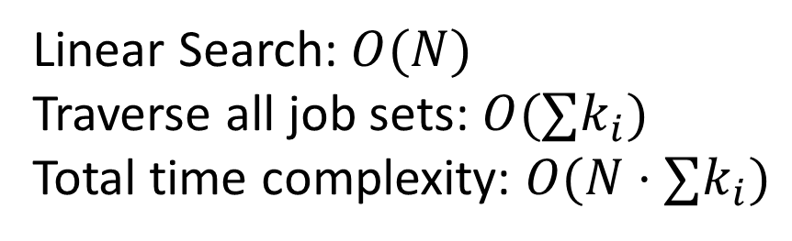
Concept (1-3) Find()
int Find(vector<int> &v, int target) {
for(int i = 0; i < v.size(); i++) {
if(v[i] == target) return i; //return target’s index
}
return -1//didn’t find the target
}
Linear Search: $O(N)$
Traverse all job sets: $O(∑k_{i})$
Total time complexity: $O(N⋅∑k_{i})$

Slide 28


Concept (1-4) Time Complexity
Total time complexity: $O(N⋅∑k_{i})$
In this test case: $N≤100, ∑k_{i}≤{10}^{6}, N⋅∑k_{i}≃{10}^{8}$
會
AC
喔

Slide 29
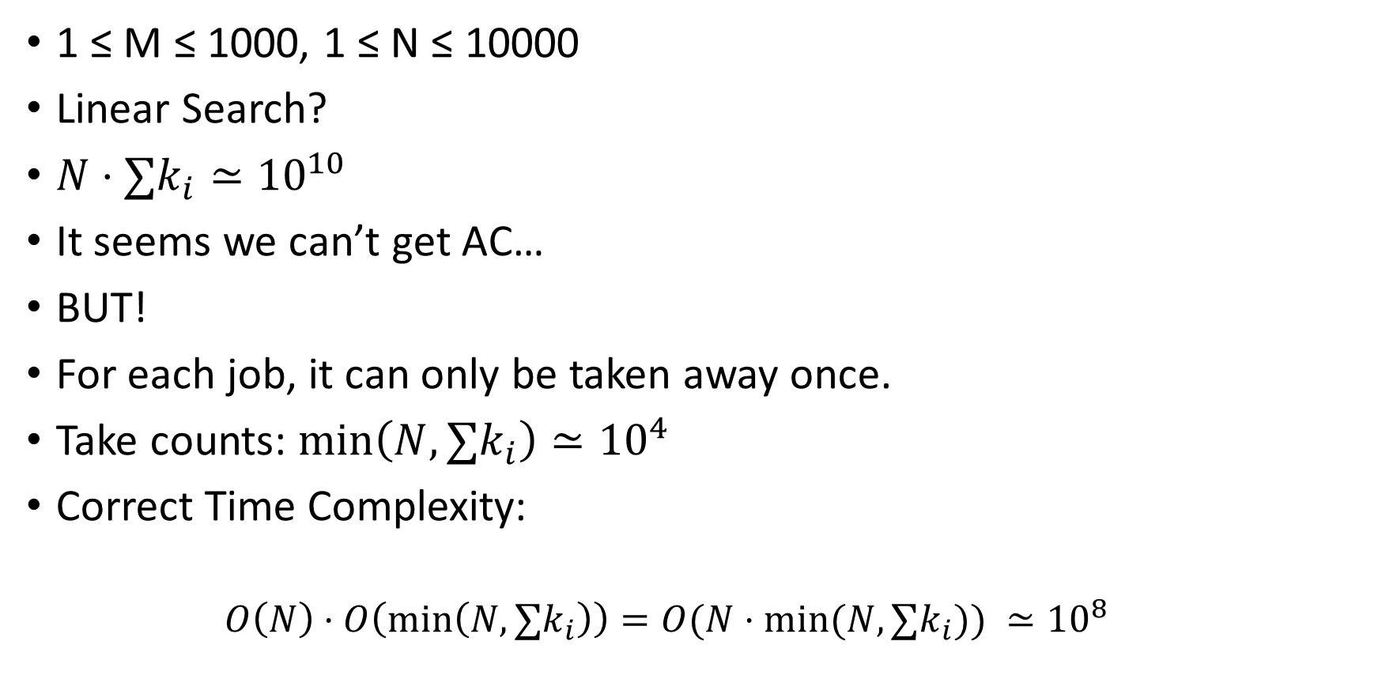
Concept (2-1)
1 ≤ M ≤ 1000, 1 ≤ N ≤ 10000
Linear Search?
$N⋅∑k_{i}≃{10}^{10}$
It seems we can’t get AC…
BUT!
For each job, it can only be taken away once.
Take counts: $\min\left(N, ∑k_{i}\right)≃{10}^{4}$
Correct Time Complexity:
$$O\left(N\right)⋅O\left(\min\left(N, ∑k_{i}\right)\right)=O(N⋅\min{(N, ∑k_{i})) }≃{10}^{8}$$

Slide 30

Concept (3-1)
$1 ≤ M ≤ {10}^{6}, 1 ≤ N ≤ {10}^{6}$
$N⋅min⁡(N, ∑k_{i})≃{10}^{12}$
Linear Search will be too slow!
How can we improve the search speed?
We can use std::map!

Slide 31
Concept (3-2) Input job type data
map<int, queue<int>> job_type;// job types for n jobs
for(int i = 0; i < n; i++) {
int t; cin >> t;
job_type[t].push(i);
}
job_type[t] stores type t’s indices (positions)
Why use queue?
Since it is a FIFO data structure!
Among jobs of the same type t, we always take the one with the smallest index.
=> job_type[t].front(), job_type[t].pop()

Slide 32
Concept (3-2) Input job type data
sample input
N = 10
N job types:
2, 1, 1, 4, 4, 3, 2, 2, 1, 3
map<int, queue<int>> job_type;
job_type[1] = {};
job_type[2] = {};
job_type[3] = {};
job_type[4] = {};

Slide 33
Concept (3-2) Input job type data
sample input
N = 10
N job types:
2, 1, 1, 4, 4, 3, 2, 2, 1, 3
map<int, queue<int>> job_type;
job_type[1] = {};
job_type[2] = {0};
job_type[3] = {};
job_type[4] = {};

Slide 34
Concept (3-2) Input job type data
sample input
N = 10
N job types:
2, 1, 1, 4, 4, 3, 2, 2, 1, 3
map<int, queue<int>> job_type;
job_type[1] = {1};
job_type[2] = {0};
job_type[3] = {};
job_type[4] = {};

Slide 35
Concept (3-2) Input job type data
sample input
N = 10
N job types:
2, 1, 1, 4, 4, 3, 2, 2, 1, 3
map<int, queue<int>> job_type;
job_type[1] = {1, 2};
job_type[2] = {0};
job_type[3] = {};
job_type[4] = {};

Slide 36
Concept (3-2) Input job type data
sample input
N = 10
N job types:
2, 1, 1, 4, 4, 3, 2, 2, 1, 3
map<int, queue<int>> job_type;
job_type[1] = {1, 2};
job_type[2] = {0};
job_type[3] = {};
job_type[4] = {3};

Slide 37
Concept (3-2) Input job type data
sample input
N = 10
N job types:
2, 1, 1, 4, 4, 3, 2, 2, 1, 3
map<int, queue<int>> job_type;
job_type[1] = {1, 2};
job_type[2] = {0};
job_type[3] = {};
job_type[4] = {3, 4};

Slide 38
Concept (3-2) Input job type data
sample input
N = 10
N job types:
2, 1, 1, 4, 4, 3, 2, 2, 1, 3
map<int, queue<int>> job_type;
job_type[1] = {1, 2};
job_type[2] = {0};
job_type[3] = {5};
job_type[4] = {3, 4};

Slide 39
Concept (3-2) Input job type data
sample input
N = 10
N job types:
2, 1, 1, 4, 4, 3, 2, 2, 1, 3
map<int, queue<int>> job_type;
job_type[1] = {1, 2};
job_type[2] = {0, 6};
job_type[3] = {5};
job_type[4] = {3, 4};

Slide 40
Concept (3-2) Input job type data
sample input
N = 10
N job types:
2, 1, 1, 4, 4, 3, 2, 2, 1, 3
map<int, queue<int>> job_type;
job_type[1] = {1, 2};
job_type[2] = {0, 6, 7};
job_type[3] = {5};
job_type[4] = {3, 4};

Slide 41
Concept (3-2) Input job type data
sample input
N = 10
N job types:
2, 1, 1, 4, 4, 3, 2, 2, 1, 3
map<int, queue<int>> job_type;
job_type[1] = {1, 2, 8};
job_type[2] = {0, 6, 7};
job_type[3] = {5};
job_type[4] = {3, 4};

Slide 42
Concept (3-2) Input job type data
sample input
N = 10
N job types:
2, 1, 1, 4, 4, 3, 2, 2, 1, 3
map<int, queue<int>> job_type;
job_type[1] = {1, 2, 8};
job_type[2] = {0, 6, 7};
job_type[3] = {5, 9};
job_type[4] = {3, 4};

Slide 43
Concept (3-3) Find()
int Find(map<int, queue<int>> &mp, int target) {
if(mp.count(target) && mp[target].size() > 0) {
return mp[target].front(); // return the smallest index for type "target"
}
else {
return -1; //not found
}
}
mp.count(target): check if we have type “target” recorded
mp[target].size() > 0: check if the jobs of type “target” have all been taken or not
mp[target].front(): return job type “target”‘s smallest index

Slide 44
Concept (3-4) Solution
vector<int> ans(n);// job i is taken by ans[i]
for(int i = 0; i < m; i++) {
vector<int> job_taken_list;
for(int j = 0; j < job_set[i].size(); j++) {
int index = Find(job_type, job_set[i][j]);
if(index == -1) {// cannot find a job he wants
print(ans); return 0;
}
job_taken_list.push_back(index); // which jobs he has taken
job_type[job_set[i][j]].pop();
}
// update answer
for(int j = 0; j < job_taken_list.size(); j++) {
ans[job_taken_list[j]] = i + 1;
}
}
// output answer
print(ans);
“Use queue’s pop to remove the job type job_set[i][j] with the smallest index”

Slide 45
Concept (3-4) Solution
sample input
Job index they take:
M = 4
M job sets:
2
1 2
3
2 3 4
1
4
2
2 3
M = 4
M job sets:
map<int, queue<int>> job_type;
job_type[1] = {1, 2, 8};
job_type[2] = {0, 6, 7};
job_type[3] = {5, 9};
job_type[4] = {3, 4};

Slide 46
Concept (3-4) Solution
sample input
Job index they take:
M = 4
M job sets:
2
1 2
3
2 3 4
1
4
2
2 3
M = 4
M job sets:
1
map<int, queue<int>> job_type;
job_type[1] = {2, 8};
job_type[2] = {0, 6, 7};
job_type[3] = {5, 9};
job_type[4] = {3, 4};

Slide 47
Concept (3-4) Solution
sample input
Job index they take:
M = 4
M job sets:
2
1 2
3
2 3 4
1
4
2
2 3
M = 4
M job sets:
1, 0
map<int, queue<int>> job_type;
job_type[1] = {2, 8};
job_type[2] = {6, 7};
job_type[3] = {5, 9};
job_type[4] = {3, 4};

Slide 48
Concept (3-4) Solution
sample input
Job index they take:
M = 4
M job sets:
2
1 2
3
2 3 4
1
4
2
2 3
M = 4
M job sets:
1, 0
6
map<int, queue<int>> job_type;
job_type[1] = {2, 8};
job_type[2] = {7};
job_type[3] = {5, 9};
job_type[4] = {3, 4};

Slide 49
Concept (3-4) Solution
sample input
Job index they take:
M = 4
M job sets:
2
1 2
3
2 3 4
1
4
2
2 3
M = 4
M job sets:
1, 0
6, 5
map<int, queue<int>> job_type;
job_type[1] = {2, 8};
job_type[2] = {7};
job_type[3] = {9};
job_type[4] = {3, 4};

Slide 50
Concept (3-4) Solution
sample input
Job index they take:
M = 4
M job sets:
2
1 2
3
2 3 4
1
4
2
2 3
M = 4
M job sets:
1, 0
6, 5, 3
map<int, queue<int>> job_type;
job_type[1] = {2, 8};
job_type[2] = {7};
job_type[3] = {9};
job_type[4] = {4};

Slide 51
Concept (3-4) Solution
sample input
Job index they take:
M = 4
M job sets:
2
1 2
3
2 3 4
1
4
2
2 3
M = 4
M job sets:
1, 0
6, 5, 3
4
map<int, queue<int>> job_type;
job_type[1] = {2, 8};
job_type[2] = {7};
job_type[3] = {9};
job_type[4] = {};

Slide 52
Concept (3-4) Solution
sample input
Job index they take:
M = 4
M job sets:
2
1 2
3
2 3 4
1
4
2
2 3
M = 4
M job sets:
1, 0
6, 5, 3
4
7
map<int, queue<int>> job_type;
job_type[1] = {2, 8};
job_type[2] = {};
job_type[3] = {9};
job_type[4] = {};

Slide 53
Concept (3-4) Solution
sample input
Job index they take:
M = 4
M job sets:
2
1 2
3
2 3 4
1
4
2
2 3
M = 4
M job sets:
1, 0
6, 5, 3
4
7, 9
map<int, queue<int>> job_type;
job_type[1] = {2, 8};
job_type[2] = {};
job_type[3] = {};
job_type[4] = {};

Slide 54
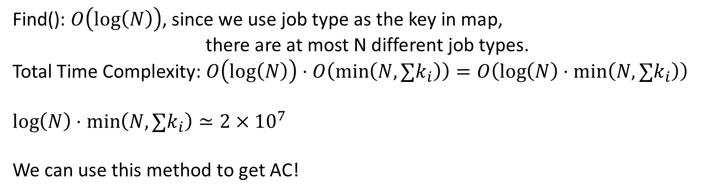
Concept (3-5) Time Complexity
Find(): $O\left(log\left(N\right)\right)$, since we use job type as the key in map,
there are at most N different job types.
Total Time Complexity: $O\left(log\left(N\right)\right)⋅O\left(\min\left(N, ∑k_{i}\right)\right)=O\left(\log\left(N\right)⋅\min\left(N, ∑k_{i}\right)\right)$
$$\log\left(N\right)⋅\min\left(N, ∑k_{i}\right)≃2×{10}^{7}$$
We can use this method to get AC!

